Slide 1



SOCIAL BUZZ PROJECT

Slide 2


Today's agenda
Project recap
Problem
The Analytics team
Process
Insights
Summary

Slide 3


Social Buzz emphasizes content by keeping all users anonymous, only tracking user reactions on every piece of content
Over the past 5 years, Social Buzz has reached over 500 million active users each month and are in need for an advisory firm to oversee their scaling process effectively.
Project Recap

Slide 4


Problem
- An analysis of their content categories that highlights the top 5 categories with the largest aggregate popularity

Slide 5



Andrew Fleming (Chief Technical Architect)
The Analytics team
Marcus Rompton (Senior Principle)
Oyedele Ayomide

Slide 6

Understood the data available using the data model
Process
1
2
Chose the data useful for analysis
3
Downloaded the dataset
4
Data cleaning and manipulation
5
Data analysis

Slide 7


Insights
From the analysis, the top five categories based on scores are education, science, Veganism, tennis and public speaking
It was also discovered that the different types of content performance differed based on the month. Photos doing better on some months and the other types performing better on other months
For the categories, studying seemed to have performed poorly in all months and science being the top category.
The reaction type “superlove” according to the numbers is a favourite by users
The Travel category is the most popular category with a score of 58,946 and a reaction type of adore 7344
The popular type of content is photo with the best performing month as July and lowest performing month in February

Slide 8
TOP FIVE CATEGORIES BASED ON AGGREGATE SCORES

Slide 9
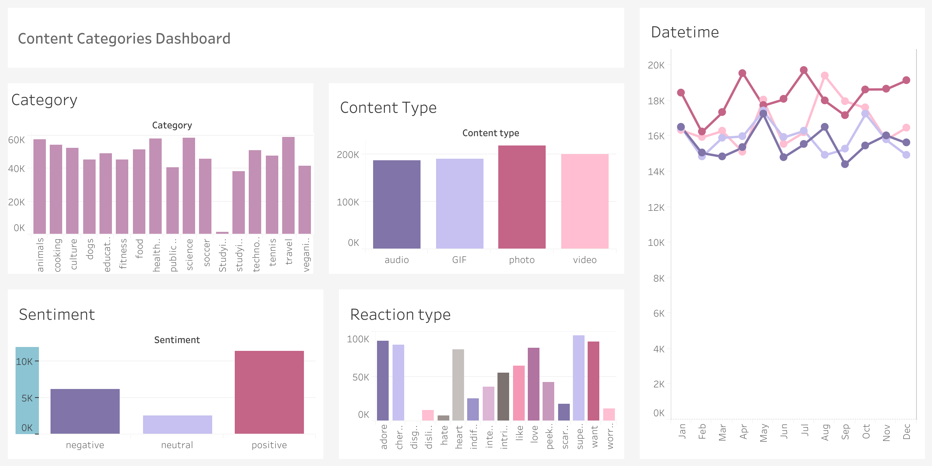

Slide 10


Getting more creators to create more on the top five categories which the public enjoys increases engagement
Summary
To boost the studying content, employing more creative studying content could potentially increase the engagement of this category. This is further supported by the high number of users interested in education content
The diverse reaction type has led to a huge interaction with both the content and the app

Slide 11

Thank you!
ANY QUESTIONS?

